Slide 1

RabbitMQ Tutorial
2019-02-06
Randy Van
Notes:
Disclaimer
About 1 month experience
Using AMPQ (default) instead of MQTT or STOMP
General overview, some things skimmed over or some obvious

Slide 2
Disclaimer
~ 1 month of experience
Using AMPQ (default) not MQTT / STOMP
General overview, some things are skimmed

Slide 3
Lesson Plan
What is RabbitMQ?
How it works
RabbitMQ vs Kafka
Lessons Learned
Q/A
Coding Tutorial
Configuration

Slide 4
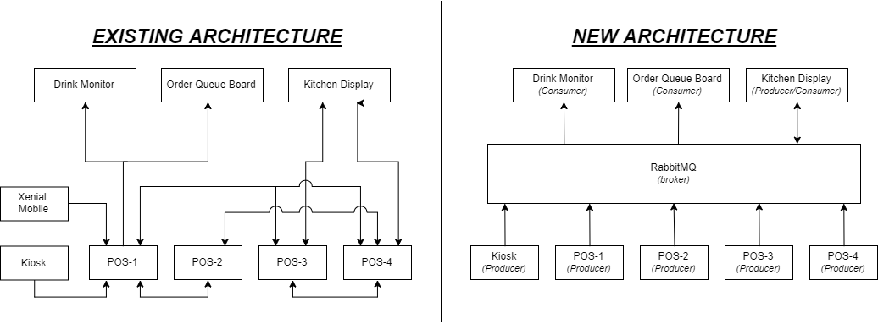
Context
Notes:
Why are we having this conversation in the first place
The existing architecture is somewhat messy
Pre-defined connection points
Memorize who talks to what
Debugging nightmare
What we want to do is have a standard for communication between applications that:
provides flexibility in our in-store system
improves app visibility and control
[identify who sent message, where it goes, make any changes to message, etc]

Slide 5
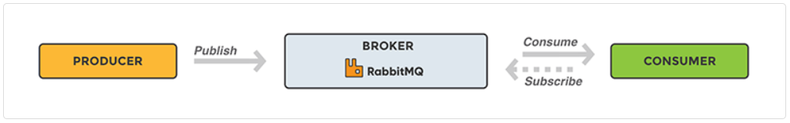
What is RabbitMQ?
Message Broker – ESB
Publish / Subscribe model
Quick, distributed messages to multiple consumers
https://www.cloudamqp.com/blog/2015-05-18-part1-rabbitmq-for-beginners-what-is-rabbitmq.html
Notes:
So in comes RabbitMQ
We are using it as an in-store enterprise service bus
Central middleware for connecting different applications
It uses a producer / consumer model
AKA a publish and subscribe model
Say, POS produce orders and KDS will consume it.
Typically, this benefits systems where many applications will consume the same message from one producer

Slide 6
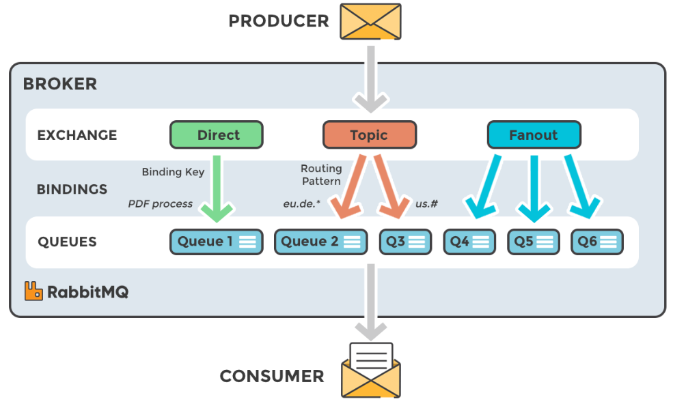
How Does It Work?
https://www.cloudamqp.com/blog/2015-05-18-part1-rabbitmq-for-beginners-what-is-rabbitmq.html
Notes:
This one image encapsulates the model as a whole
The key members of Rabbmq message broker are the exchanges and queues

Slide 7
Exchange
“The core idea in the messaging model in RabbitMQ is that the producer never sends any messages directly to a queue. Actually, quite often the producer doesn’t even know if a message will be delivered to any queue at all.” - RabbitMQ
https://www.rabbitmq.com/tutorials/tutorial-three-javascript.html
Notes:
This philosophy is rather important
Exchange are configured with a type that determines how messages are forwarded from the exchange to a queue

Slide 8
Exchange
“The core idea in the messaging model in RabbitMQ is that the producer never sends any messages directly to a queue. Actually, quite often the producer doesn’t even know if a message will be delivered to any queue at all.” - RabbitMQ
Message Forwarding
Types
Direct - key
Topic - pattern
Fanout – broadcast
https://www.rabbitmq.com/tutorials/tutorial-three-javascript.html
Notes:
Exchange are configured with a type that determines how messages are forwarded from the exchange to a queue

Slide 9
Exchange Types
 | Direct
Message Forwarding Description | Queue binding key matches the message routing key. routingKey = bindingKey
Where Configured | Producer, Exchange, Queue
Example routing key | routingKey = ‘order’
Example binding key | bindingKey = ‘order’
Notes:
- Like sending a message to Brent

Slide 10
Exchange Types
 | Direct | Topic
Message Forwarding Description | Queue binding key matches the message routing key. routingKey = bindingKey | Queue filtering, queues with matching routing patterns
Where Configured | Producer, Exchange, Queue | Producer, Exchange, Queue
Example routing key | routingKey = ‘order’ | routingPattern = FOH.3rd
Example binding key | bindingKey = ‘order’ | bindingPattern = FOH.3rd bindingPattern = *.3rd bindingPattern = FOH.* bindingPattern = #.3rd bindingPattern = FOH.# * - one word placeholder # - any num placeholders
Notes:
- Sending a message to Front of House, or anyone that’s on 3rd Floor

Slide 11
Exchange Types
 | Direct | Topic | Fanout
Message Forwarding Description | Queue binding key matches the message routing key. routingKey = bindingKey | Queue filtering, queues with matching routing patterns | Broadcast to all queues bound to the exchange
Where Configured | Producer, Exchange, Queue | Producer, Exchange, Queue | Exchange
Example routing key | routingKey = ‘order’ | routingPattern = FOH.3rd | N/A
Example binding key | bindingKey = ‘order’ | bindingPattern = FOH.3rd bindingPattern = *.3rd bindingPattern = FOH.* bindingPattern = #.3rd bindingPattern = FOH.# * - one word placeholder # - any num placeholders | N/A
Notes:
- Sending a message to everyone at taco bell

Slide 12
Pop Quiz Time

Slide 13
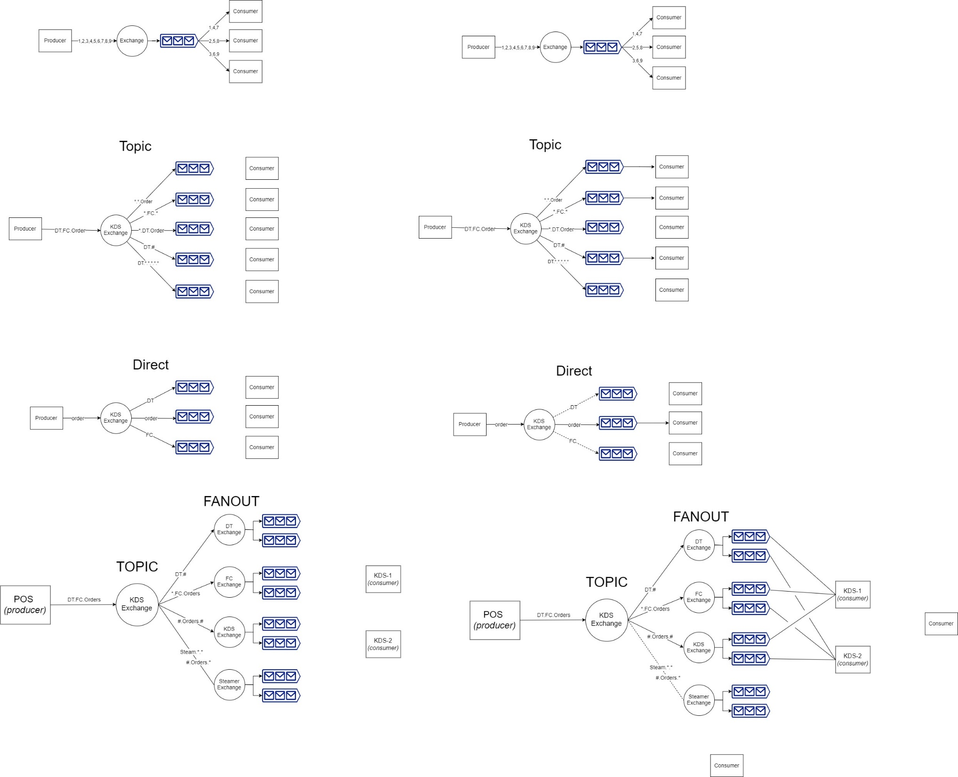
Quiz Architecture 1

Slide 14
Quiz Architecture 1

Slide 15
Quiz Architecture 2

Slide 16
Quiz Architecture 2

Slide 17
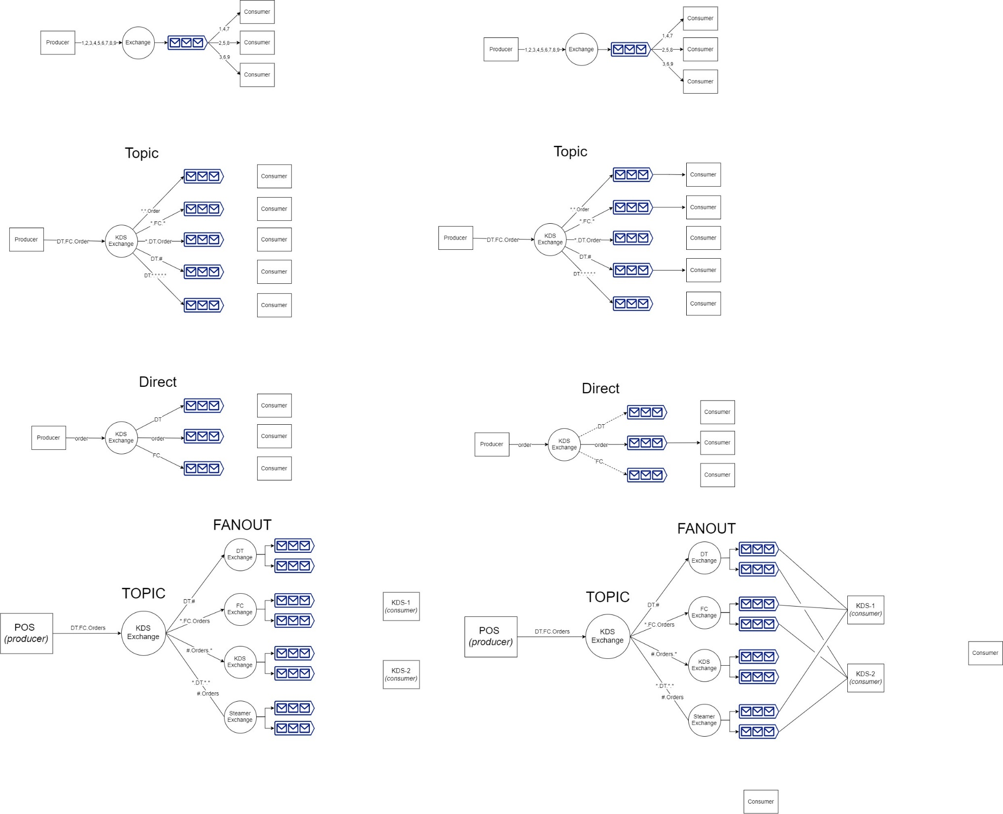
Quiz Architecture 3

Slide 18
Quiz Architecture 3

Slide 19
When to Use Which?
Direct
Few consumers
Producer needs lots of control for which consumer receives message
Topic
When consumers are easily grouped / categorized
Large systems
Fanout
Low configuration
Flexible consumers

Slide 20
Any Questions So Far?

Slide 21
Queue
Bind queue to exchange
1 (ex) to many (q) relationship
Follows exchange type
Often Consumer-side
Notes:
Queue has to be bound to an exchange
has binding key if direct
Has binding pattern if topics

Slide 22
Queue
Bind queue to exchange
1 (ex) to many (q) relationship
Follows exchange type
Often Consumer-side
One Consumer per queue
FIFO
Auto-load balancing
Consuming is destructive
Notes:
True to its name, it is queue as a data structure
Once consume a message in queue, it is ack and is removed from queue

Slide 23
Queue
Bind queue to exchange
1 (ex) to many (q) relationship
Follows exchange type
Often Consumer-side
One Consumer per queue
FIFO
Auto-load balancing
Consuming is destructive
No message replay
Pre-defined queues
Notes:
Queue has to be bound to an exchange
has binding key if direct
Has binding pattern if topics

Slide 24
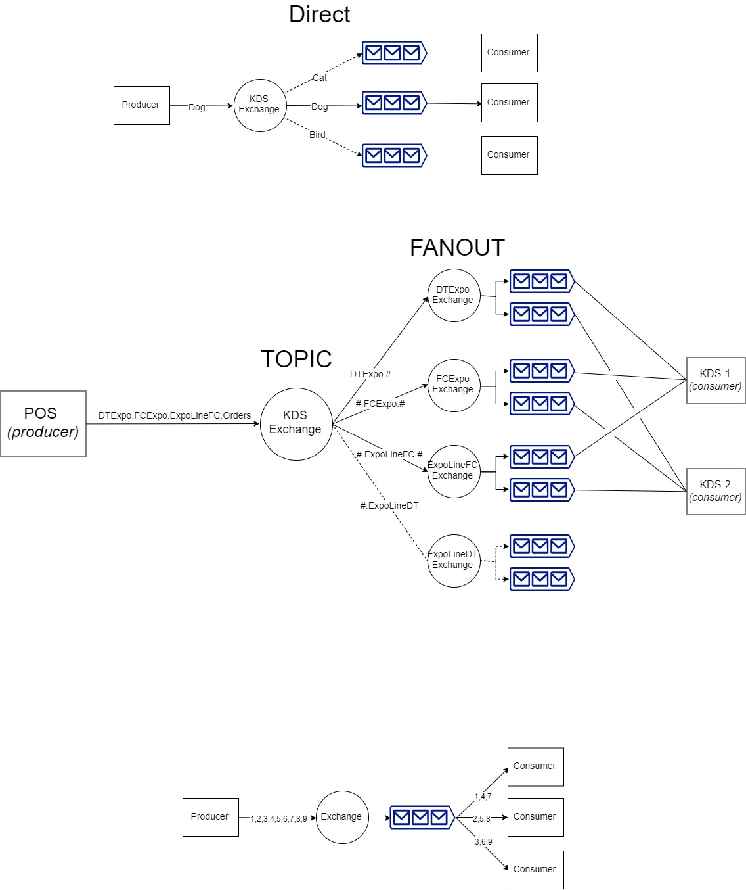
One Consumer Per Queue?
Notes:
- Consuming from a shared queue will lead to round-robin auto-load balancing

Slide 25
No Message Replay?
Consumer-made queues only get new messages
Cannot query for previous messages*
*May be limitation of AMPQ protocol, not necessarily RabbitMQ
Notes:
- Consumers that make queues will only get newest messages after conception of queue
- Inherently flawed, as DC will remove any benefits of pre-queueing

Slide 26
No Message Replay?
Consumer-made queues only get new messages
Cannot query for previous messages*
Pre-Queueing
Consumer has less flexibility
No failure tolerance
Against the design principal of RabbitMQ
*May be limitation of AMPQ protocol, not necessarily RabbitMQ
Notes:
- Consumers that make queues will only get newest messages after conception of queue
- Inherently flawed, as DC will remove any benefits of pre-queueing

Slide 27
RabbitMQ vs. Kafka
RabbitMQ | Kafka
Great support for devs Plugins for existing protocols Open-source Lightweight Exchange / Queue Complex routing Control per-message | More built-in features Topics Persistent data .properties files for config
https://content.pivotal.io/blog/understanding-when-to-use-rabbitmq-or-apache-kafka

Slide 28
Lessons Learned
Use exchanges with limited scope
Notes:
Hard to keep track of exchanges that do too much

Slide 29
Lessons Learned
Use exchanges with limited scope
Use more exchanges instead of complex topics / direct messages
Notes:
Hard to keep track of exchanges that do too much

Slide 30
Lessons Learned
Use exchanges with limited scope
Use more exchanges instead of complex topics / direct messages
Fanout is a lot easier to configure
Notes:
Hard to keep track of exchanges that do too much

Slide 31
Lessons Learned
Use exchanges with limited scope
Use more exchanges instead of complex topics / direct messages
Fanout is a lot easier to configure
Boot order can matter without pre-queueing
Notes:
Hard to keep track of exchanges that do too much

Slide 32
Lessons Learned
Use exchanges with limited scope
Use more exchanges instead of complex topics / direct messages
Fanout is a lot easier to configure
Boot order can matter without pre-queueing
Architecture matters, but RabbitMQ can only do so much
Don’t make it do something it’s not meant for
Notes:
If need prior data, best to use a server than making lots of pre-queues or backup queues

Slide 33
Further Learning
https://jack-vanlightly.com/blog/2017/12/5/rabbitmq-vs-kafka-part-2-rabbitmq-messaging-patterns-and-topologies
https://www.cloudamqp.com/blog/2017-12-29-part1-rabbitmq-best-practice.html
https://www.cloudamqp.com/blog/2018-01-19-part4-rabbitmq-13-common-errors.html

Slide 34
Q/A

Slide 35
CODING

Slide 36
Docker and RabbitMQ Setup
Docker:
https://www.docker.com/products/docker-desktop
https://hub.docker.com/_/rabbitmq
Visual Studio Code
https://code.visualstudio.com/
NodeJS
https://nodejs.org/en/
Code
https://github.com/ryaovan/rabbitmq-tutorial
5 min break

Slide 37
Coding Example 1
API:
http://www.squaremobius.net/amqp.node/channel_api.html
Steps:
1. Open connection to RabbitMQ
2. Create Channel
Create Direct Exchange
3. Create Consumer Channel
Create Queue
Bind queue
Consume
4. Create Producer Channel
Send Message
Notes:
One channel per thread

Slide 38
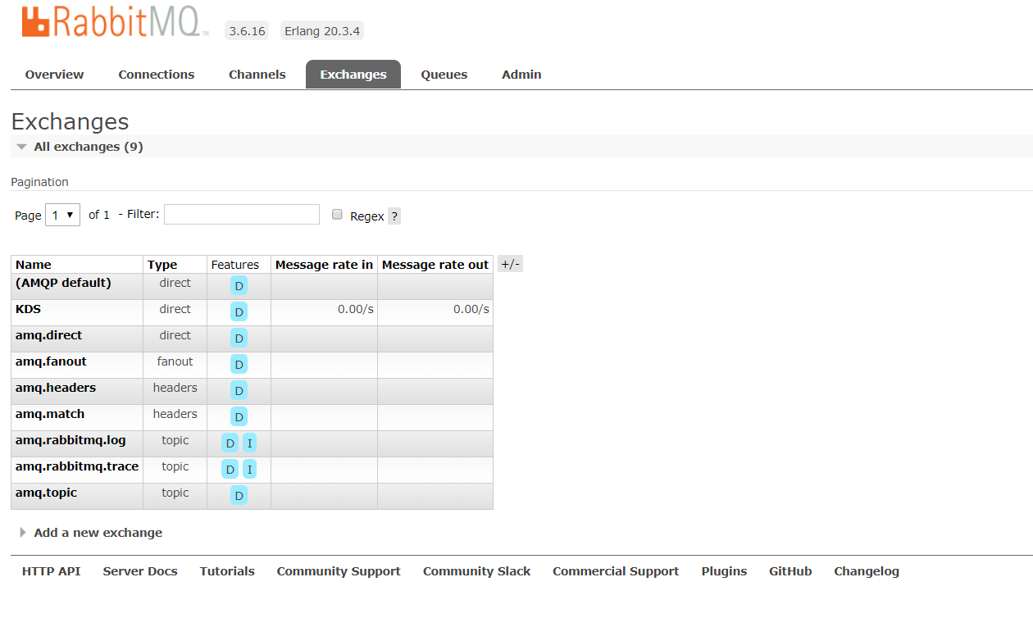
Management Console

Slide 39
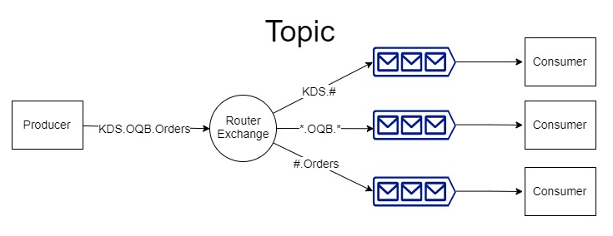
Coding Example 2A
1 exchange [Router2A]
Topic
Pattern = ‘KDS.OQB.Orders’
3 Consumers
KDS, OQB, Orders
1 for each of pattern

Slide 40
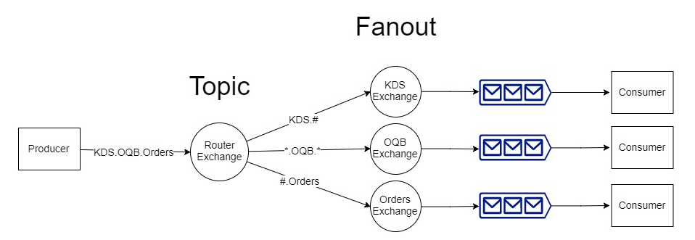
Coding Example 2B
4 exchange [Router2B, KDS2B, etc.]
Topic -> Fanout
Pattern = ‘KDS.OQB.Orders’
3 Consumers
KDS, OQB, Orders
FANOUT CONSUMERS

Slide 41
Closing Statements: Configuring
Vhost – container for exchanges and queues
Reliability / failure – clustering, high-availability, heartbeats
https://www.rabbitmq.com/reliability.html
Prefetch – number of unack messages consumer can take at once
One connection, many channels
Connections take up a TCP/IP port
Don’t open and close channels / connections repeatedly
Queue:
Depth limits
Priority queues: high priority message

